Slide 1
Lab Problems

Slide 2
Problem -1
Box
- float width
- float height
- float length
Create a Box class
Use member methods to calculate the surface area and volume of the box.
Box()
Box(w,h,l)
+ float getWidth()
+ float getHeight()
+ float getLength()
+ void setWidth(w)
+ void setHeight(h)
+ void setLength(l)
+ float getArea()
+ float getVolume()

Slide 3
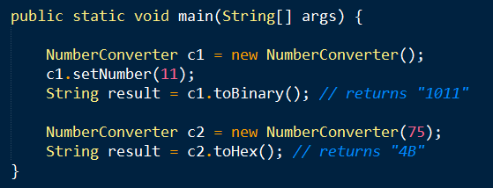
Problem-2
NumberConverter
Create a Number converter class that will convert a given integer number to Decimal, Octal, Hexadecimal or Binary
- int number
NumberConverter()
NumberConverter(int n)
+ int getNumber()
+ void setNumber(int n)
+ String toDecimal()
+ String toHex()
+ String toBinary()
+ String toOctal()

